Slide 1

Summer Coding Camp 2022
Class - 4
Cheminformatics, Bash scripts, Computational Chemistry

Slide 2
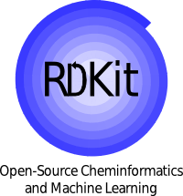

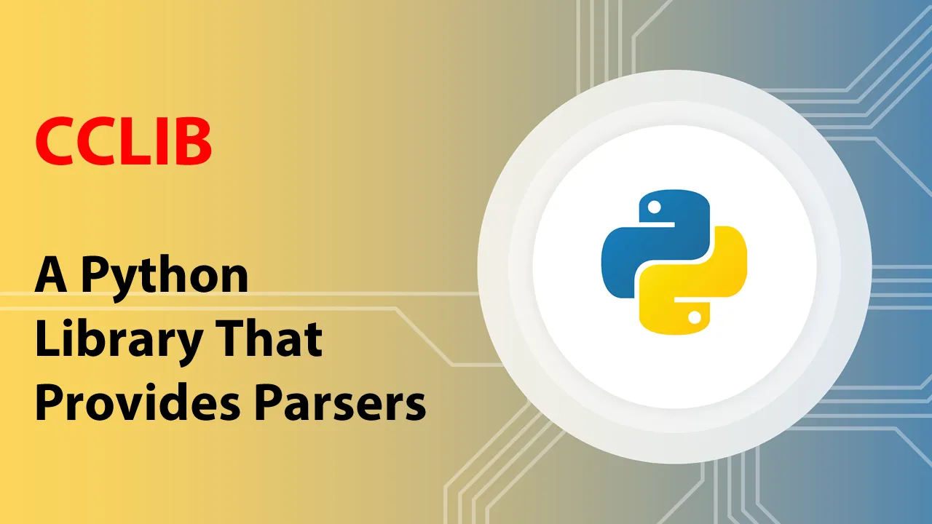
Contents
Today’s Basic outline
Molecular representations
Rdkit
Creating molecules
Bash scripting -> running computational calculations
Cclib
Output analysis
AQME

Slide 3
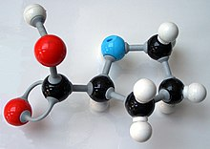
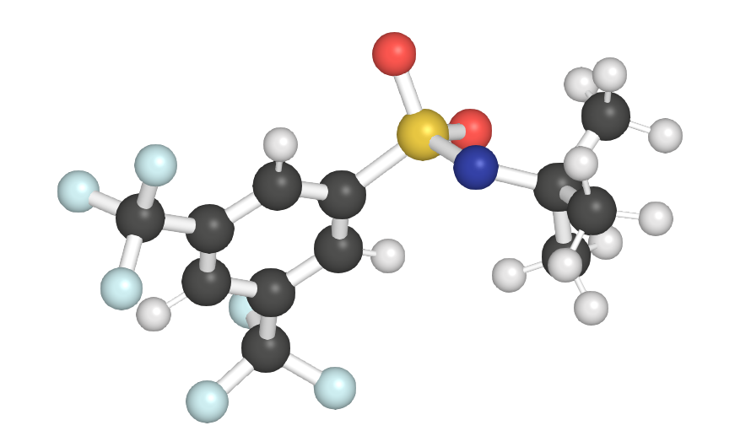
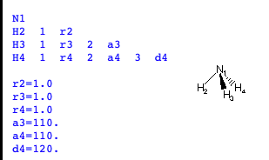
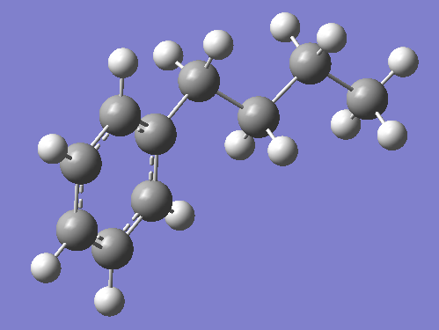
Molecular representations
Making molecules – 3D
Molecular model
Computationally
Software's such as gaussian, pymol, Avogadro, molden
How do these software's create them?
specify distances, angles dihedrals
Impossible to do for all structures.
Other representations of molecules
ChemDraw
2D
Notes:
Scripting simple terms – Typically, a script is a lightweight, quickly constructed, possibly single-use tool. It's usually interpreted, not compiled. Python and bash are examples of languages used to build scripts.
view a script in a text editor to see what it does.
Program - A program is constructed in a compiled language, like C or C++
Run quicker
the latter's instructions have been compiled into bytecode or machine language that makes it very difficult for humans to understand, without specialized tools.

Slide 4
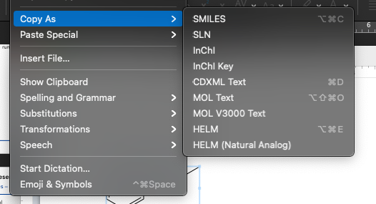
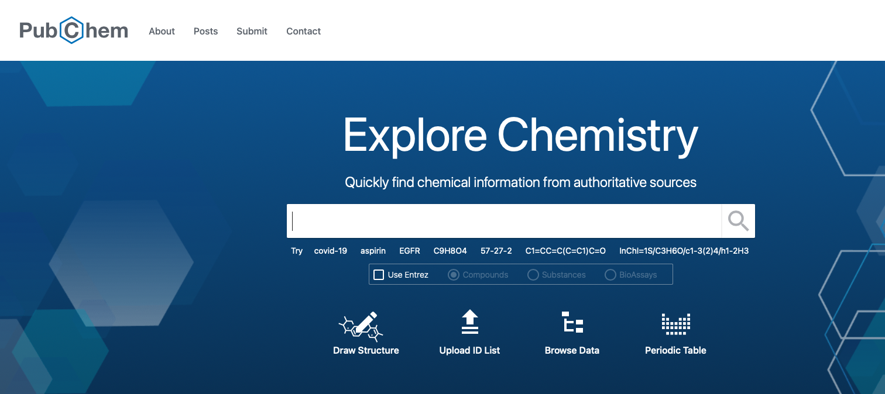
Molecular representations
2D
From a ChemDraw -> Get representation of molecule
SMILES
CCCC1=CC=CC=C
SLN
CCCC[4]=CC=CC=C@5
InChI
ODLMAHJVESYWTB-UHFFFAOYSA-N
InChI Key
ODLMAHJVESYWTB-UHFFFAOYSA-N
How can you use theses?
Google these you can get existing 3D coordinates
https://pubchem.ncbi.nlm.nih.gov/
Check the above link -> get the benzaldehyde structure
https://pubchem.ncbi.nlm.nih.gov/compound/240

Slide 5
RDKit
2D -> 3D
PubChem
Existing structure
Not effective for large set of molecules
They have a Python API module but still its only for molecules that are on there
To extend to any new molecule for 3D structure
Cheminformatics packages -> RDKit, Openbabel
RDKit
Useful library to do multiple things
Create 3D structures
Get properties of molecules
Generate products of reactions between reactants
https://pubchem.ncbi.nlm.nih.gov/compound/240

Slide 6
Bash Scripting
Running on clusters
Scripting language used for high performance computing
Running large programs
Gaussian
Turbomol
ORCA
Can generally run small python scripts in it as well
Used to allocate computational resources

Slide 7
CCLlib
Output analysis
Parser for analyzing computational outputs
Used to gather necessary computational data
Can handle multiple computational chemistry programs!

